Slide 1
The ABC’s of Teacher Retirement

Slide 2
Disclosures
The presentation to follow is intended to educate consumers regarding the importance of comprehensive planning as one nears or enters retirement. While great care was taken in the development of this content, the presentation should not be construed as an exhaustive look at retirement planning. Retirement planning is a complex subject and should be personalized based on the goals, needs and resources of each person.
Nothing in this presentation should be construed as the giving of investment, tax or legal advice. You are encouraged to seek qualified assistance from an attorney, accountant or qualified financial professional regarding these topics.
The presenter, nor the contents of this presentation, have been endorsed by nor are they affiliated with the Social Security Administration or any governmental or regulatory agency of the federal or state government.
A number of financial products or solutions, including life insurance, long term care or fixed annuities may be referenced during the presentation; however, no financial products will be offered for sale at this meeting.
The application of any financial product or service in solving a short or long term need or goal is a personal decision, and may not be suitable for every individual or every situation. Planning and product selection should be based on your age, financial objectives, short and long term financial goals, liquidity needs, risk tolerance and overall financial situation. You should review all brochures, specimen contracts, buyers guides and or disclosure forms presented before purchasing any financial product or service.
Fixed annuity earnings are tax deferred until withdrawn. Use of annuities with qualified-type plans [401(k), IRA, 403(b)] may not provide any additional tax benefits above those you already receive in such a plan. Withdrawals may be subject to income tax and a 10% federal income tax penalty if taken before age 59½. Surrender charges may apply if you withdraw more than the penalty-free amount in a year. Fixed annuities generally guarantee a minimum interest rate on all or a percentage of each contribution over the life of the contract, less any withdrawals and/or deductions and early surrender charges. Guarantees are based on the claims-paying ability of the insurer.

Slide 3
ABC’s of Teacher Retirement
Approach Retirement With Eyes Wide Open
Be Aware of ALL Your Options
Control Your Financial Future
This Photo by Unknown Author is licensed under CC BY-SA-NC

Slide 4
ABC’s of Teacher Retirement
Approach Retirement with Eyes Wide Open

Slide 5
ATRS Changes
Retirement wage is now based on top 5 years of service instead of top 3 years of service.
Noncontributory Multiplier Reduced to .0125 (1.25%)
Mortality Rates have changed. Congratulations your spouse is living longer! Which means your beneficiary option is now more expensive.
It now costs you 10% a year to retire early before 28 years of service. You are not eligible for income until 25 years of service or age 60.
TDROP Interest Rates change on an annual basis, and differ based on status.
T-Drop Amortization Rate Reduced to 3%.
Benefit Stipend has been reduced by $25.00 a month.
Increase in retirement contribution from both employer and employee. By
2022 Employer Contributions will be 15% and Employee Contributions will
be 7%.

Slide 6
Understanding Teacher Retirement
No Reduction in Benefits if 28 Years of Credited Service or Age 60.
After 25 years of Service, 10% Permanent Reduction (Per Year) for Early Retirement. (Ex: 25 Years = 30% Reduction, 26 Years = 20% Reduction, 27 Years = 10%Reduction)
If Contributory: YOU contribute 6.25% of your income (pre-tax); District contributes 14.25% of your income on your behalf.
If Non-Contributory, District contributes 14.25% on your behalf.
If you leave education early, you may “sell” your years of service.
CAUTION: Selling years of service can cost you your pension benefits and you lose the State’s 14.25% contribution. You would receive only your 6.25% pre-tax contributions.
Teaching Professionals in Arkansas can retire with an attractive retirement benefit package under the Arkansas Teacher Retirement System.

Slide 7
Calculating Your Pension
To Calculate Your Pension:
Take the average of your HIGHEST 5 Years Salary
Multiply by the number of years of credited service
.0215% for Contributory
.0125% for Non-Contributory
Current Multiplier for AR, approved by Legislature
If 10 or more years of actual service, add an additional $600.
Example:
Teacher, 28 Years of Service
Highest 5 Years Salary: $50,000
Average of Highest 5 Years of Service
Contributory Plan Participant, All Years of Service
$50,000 x 0.0215 x 28 Yrs. of Service + $600 = $30,700.00

Slide 8
ATRS Survivors Benefits – In Service
Survivor Benefits: Any active member's spouse and dependent children may qualify for survivor benefits. (NOTE: Inactive members do not have survivor benefit protection.)
Qualifications:
You must have been married at least two years immediately preceding the members death.
You must have a minimum of five years actual or reciprocal service credit.
Spousal Survivor Benefits (In-Service):
Surviving spouse shall receive survivor benefits as if the member had retired under annuity option A (100% survivor benefit.)
Surviving spouse benefits payable the month following the member's death if the member had:
reached age 60; or accumulated at least 28 of actual and reciprocal service credit; or accumulated 25 to 27.75 years of service, qualifying for early (reduced) retirement benefits
in all other cases, benefits become payable to the surviving spouse the month following the member's 60th birthday. The benefits are payable for the surviving spouse's lifetime. (NOTE: Remarriage does not cancel the spouse's survivor benefits.)

Slide 9
ATRS Survivors Benefits – In Service
Dependent Children
Surviving dependent children shall each receive an annuity equal to 20% of the member's highest salary year received in covered employment; unless there are more than three surviving dependent children.
If more than three dependent surviving children, 60% of the member's highest salary year shall be divided equally.
Benefits are payable until dependent child reaches 18 years of age or continues consecutively as a full-time student at an accredited secondary school, college, or university (up to age 23).

Slide 10
ABC’s of Teacher Retirement
Be Aware of ALL Your Options

Slide 11
Survivors Benefit Options at Retirement
Estimating Your Retirement Benefits:
Under the Arkansas Teacher Retirement System law, you may choose to retire under Option 1 (Straight Life Annuity) or one of the three benefit options: A, B, or C. These options differ in the amount paid and benefits payable to someone else after your death.
Option 1: (Straight Life Annuity) No Spousal / Survivor benefits payable
Benefit Amounts - Maximum Allowance Survivor Benefits - None
Option A: Spouse only
Benefit Amounts - Reduced Lifetime Annuity (see handout) Survivor Benefits - 100% Survivor Annuity
Option B: Spouse only
Benefit Amounts - Reduced Lifetime Annuity (see handout) Survivor Benefits - 50% Survivor Annuity
Option C: May be anyone
Benefit Amounts - Lifetime with 10 years Certain including Pop-Up Provision Survivor Benefits - Balance of 120 monthly payments after the Retiree's death

Slide 12
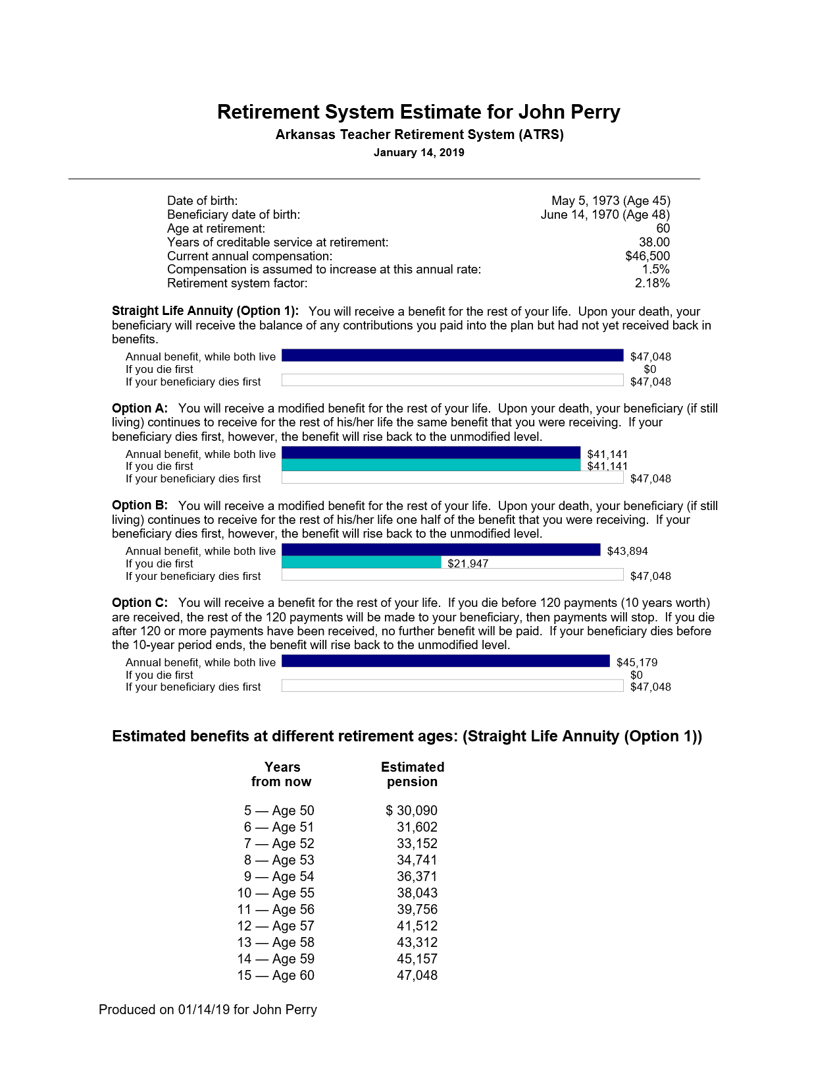

Slide 13
Health Insurance

Slide 14
The ABC’s of TDROP
You have the ability to TDROP for up to 10 years, after 28 years of service.
After 28 years of service, you are eligible for 100% of your Pension. TDROP is funded by deferring your pension and continuing to work your TDROP account will accumulate based on the following rules:
Less 1% for each year of service,
Less 6% for each year in TDROP prior to year 30.
After 28 years of service, you are eligible for 60% of your pension through TDROP.
After 30 years of service, you are eligible for 70% of your pension through TDROP.
$31,000.00 | 60% | $18,600.00
$32,075.00 | 65% | $20,848.75
$33,150.00 | 70% | $23,205.00
(Q) Does TDROP work for you? That’s a question WE can help answer!

Slide 15
Let’s face it, you’ve selected TDROP and now you have a huge suitcase full of cash…now what?
Do you give it back?
Do you spend it?
Do you make it work for you?

Slide 16
ABC’s of Teacher Retirement
Control
Your
Financial Future

Slide 17
What Vehicle is my retirement in?
PENSION (ATRS)
TDROP
403b
457
TSA (Annuity)
401K
Life Insurance
Checking
IRA
Savings
CD’s
Mutual Funds
Stocks
Real Estate

Slide 18
It’s Time To Take Your Money! Now What?
You can give it back to Teacher Retirement in exchange for a FIXED INCOME.
In whole or (if approved) in part
You can take a LUMP SUM DISTRIBUTION.
Distributions are taxable in year received.
You can take a FULL DISTRIBUTION and use the 60-Day Rule to Place into a Tax-Deferred Account
Mandatory withholding issue, only one indirect transfer permitted on a calendar year basis.
You can ROLLOVER your money to an IRA (that YOU control) and not lose control of your money.

Slide 19
Option One: Give the Money Back
If you plan to give the money back, why did you TDROP?
You may have been better off staying in the system and you will exchange your account for additional income.
You are guaranteed a return of your principal
Should you die your beneficiaries receive any unpaid balance not having been paid out in monthly payments*
You exchange your money for a fixed income
You lose control over that money going forward.
You no longer have access to a lump sum of money.
* Example: You had $200,000 in your TDROP account. You have received $160,000 in retirement benefits prior to your death. Your heirs would only receive $40,000.

Slide 20
Option Two: Lump Sum Distribution
Distributions are FULLY TAXABLE in the year received.
If you take a LUMP SUM DISTRIBUTION at retirement, 100% of that money is considered taxable income.
Because taxes increase, based on your modified, adjusted gross income, taking a lump sum distribution can push you into a higher tax bracket.
Both at the State and Federal Level
“Uncle Sam” may become an unintended recipient of your lump sum distribution.

Slide 21
Option Three : Take It Now and Re-Invest Later
Mandatory 20% Federal withholding of distributions from Teacher Retirement.
So you only receive 80% of your Teacher Retiremenet Distribution
And even though you only receive 80% of the retirement distribution, you will pay taxes on 100% of the distribution (unless you reinvest within 60 days).
Remember, you have only 60 days to reinvest 100% of the money.
If you don’t reinvest 100% within 60 days of receipt, you must pay taxes on the amount not reinvested.

Slide 22
Taxable Example of a TDROP Distribution
TDROP Balance: $200,000
Lump Sum Withdrawal: $160,000
20% Withholding = $40,000
You only have 60 days to re-invest the $200,000 into a Rollover IRA, or you pay taxes.
If you reinvest only the cash received ($160,000), you will pay taxes on the $40,000 withheld from your lump sum distribution next April 15th.

Slide 23
Option 4: Rollover TDROP to an IRA That You Control in Retirement
Allows YOU to control your TDROP funds in retirement.
Access for Emergencies and Future Investment Opportunities
You have OPPORTUNITY to benefit from future increasing interest rates, helping you minimize future inflation.
You CONTROL when and how your income is received.
Interest Only, Fixed Amount, Fixed Period of Time
Turn it On, Turn it Off, Let it Continue to Grow Tax-Deferred
You REMAIN IN CONTROL of what you’ve spent a lifetime earning and saving for your retirement.
A return OF your money is just as important (if not more so) than the return ON your money!

Slide 24
IRA Distributions and Taxes
Distributions prior to age 59-1/2 are subject to income tax, plus an additional 10% tax penalty.
After 59 ½, distributions are taxed as ordinary income in the year received, and taxes are based on your tax bracket.
You must begin taking distributions by age 70 ½ (Required Minimum Distributions)
Money grows on a tax-deferred basis until withdrawn. You don’t pay taxes until you receive the money as income in retirement.
IRS Agents are prohibited from giving tax or legal advice.
You should seek professional assistance for tax or legal questions you may have.

Slide 25
Social Security
A contributory teacher along with their social security should not have a drop in income.
Did you know Social Security Grows at 8% a year each year you defer until age 70.
Questions to ask myself?
How does this effect my Spouse?
Should I wait?
Should My spouse wait to turn on theirs?
Age and income difference is important

Slide 26
What is Our Role?
You Have Options. Our role is to help you understand them so you can make an informed decision about retirement.
We Specialize in Teacher Retirement and Social Security.
Our goal is to guide you through the process of rolling your TDROP (and other retirement plans) into a self-directed IRA.
We help you look “realistically” at your income potential through sound planning.

Slide 27
What is Our Role?
We provide you with access to Principal Protected Solutions that allow for market-linked returns without downside market risk.
We design a plan that protects your assets and allows you live within means to make your funds last!
We look to the future for your family and survivor needs and benefits.
We provide you with security of top companies you can trust with your future.

Slide 28
Benefit Solutions Group 130 E 3rd St Malvern, AR 72104 870.759.2212 benefitsolutionsgroup.net Arkansas Teacher Retirement 1-800-666-3877
ABC’s TDROP

